Slide 1
Federal Highway Administration Engineering & Software Consultants Inc.
NDE-SHM Integration Project Updates
F.L. Moon, J. Braley, N. Gucunski
September 3, 2019

Slide 2
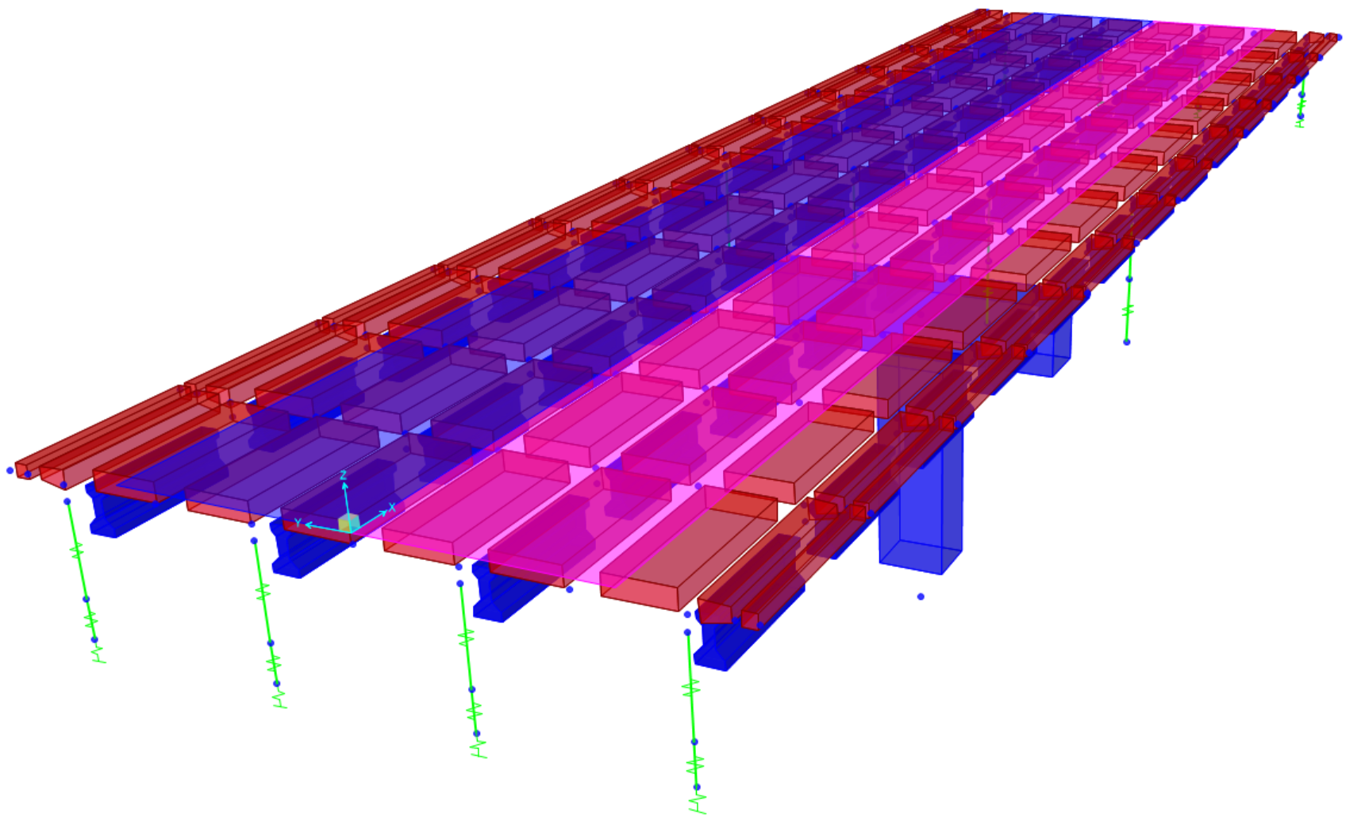
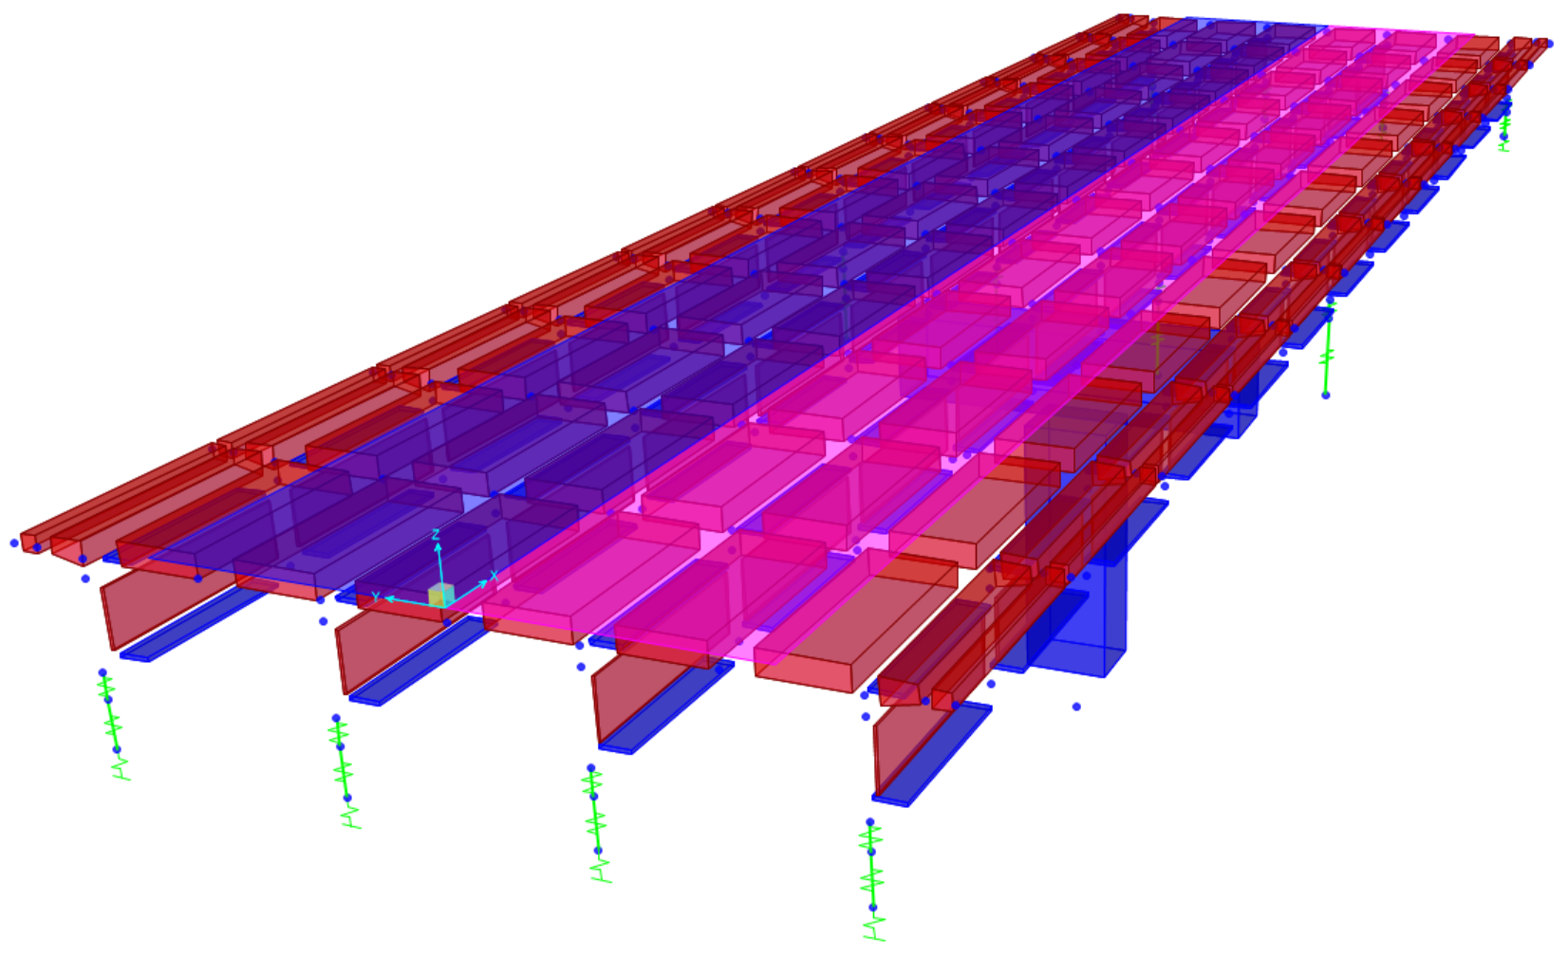
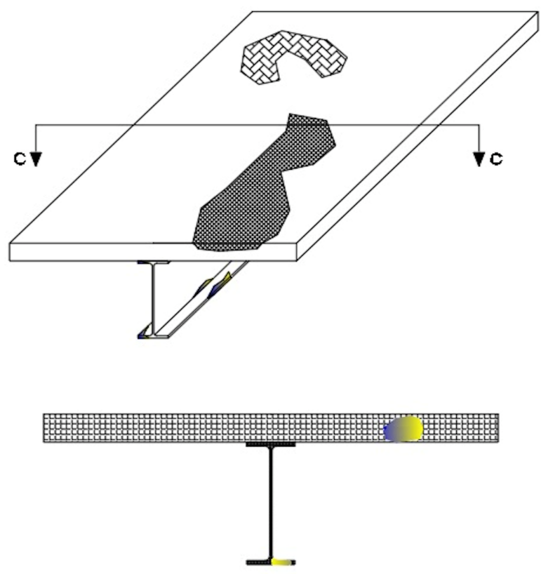
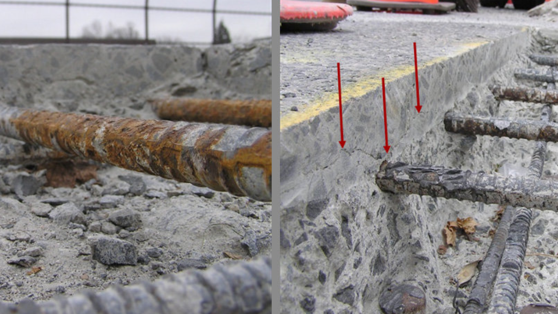
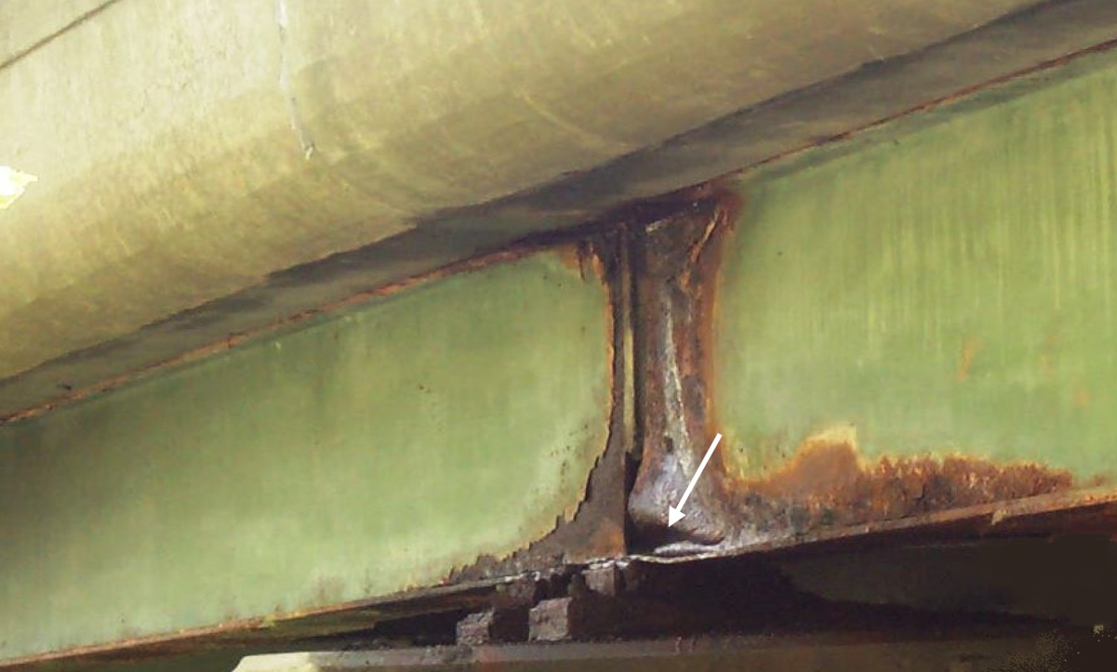
Task 2.1. Numerical Simulation (Sensitivity Analysis)
Influence of Local Deterioration on Structural Demands
Influence of Deterioration on Structural Capacity

Slide 3
Simulation of Deterioration for Capacity
Perform parametric studies to quantify the level of deterioration and bridge-specific characteristics that should be examined for the NDE-SHM integration strategies
Key bridge parameters include:
Span length (50-150 ft.)
Girder spacing (6 – 12 ft.)
Bridge Type (Steel multi-girder, PS Concrete multi-girder)
Key defect parameters
Delamination depth (2 – 4 in.)
Loss of composite action (0, 50%, 100%)
Loss of prestressing strands (1-3 strands)

Slide 4
Implementation of Fiber Model for Parametric Studies
The following steps are implemented in MATLAB.
Construct fiber model based on girder design
Step through curvature (and compute moment) to develop moment-curvature curve.
Identify/interpolate moment and curvature at capacity criterion.
Assign defect to fiber model
Repeat steps 2 & 3
These steps are performed for each bridge design and for all of the applicable defects. Loop architecture is leveraged for steps 4 & 5 to generate sensitivity data.

Slide 5
Parametric Study Output
Goal: Estimate the influence of specific defects (e.g. delaminations, prestressed tendon loss, loss of composite action) on flexural behavior
Ultimate Moment Capacity – moment associated with the failure criteria provided by the AASHTO LRFD
Ductility – the nonlinear deformation capacity of the cross-section (generally reported in terms of a ratio of yield curvature to ultimate curvature)

Slide 6
Capacity Criteria for Strength 1 Limit State
Steel
composite: plastic moment capacity - moment at first concrete crushing (top of deck)
non-composite: girder yield - moment at first yield
partial composite: the greater of first crushing and first yield
Prestressed
composite: plastic moment capacity - moment at first concrete crushing (top of deck)
non-composite: plastic moment capacity - moment at first crushing at top of girder
partial composite: check top of girder & top of deck for crushing

Slide 7
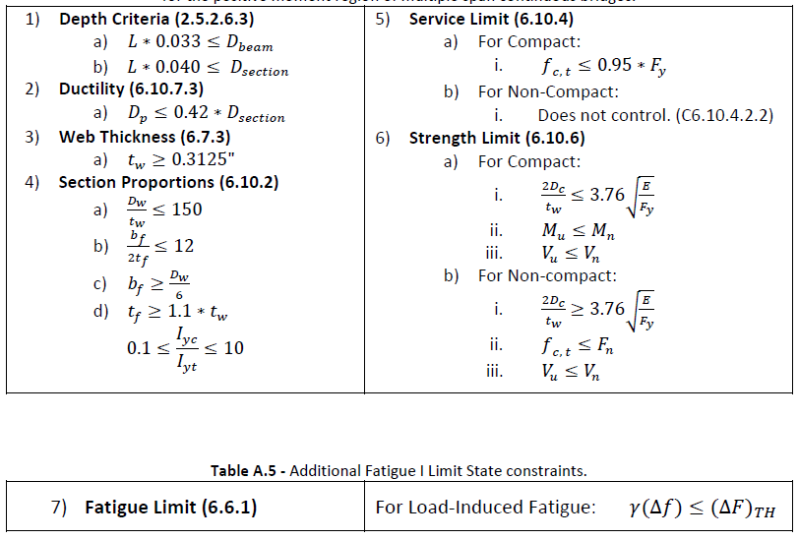
Steel Bridge Design
Minimize section area while meeting all constraints

Slide 8
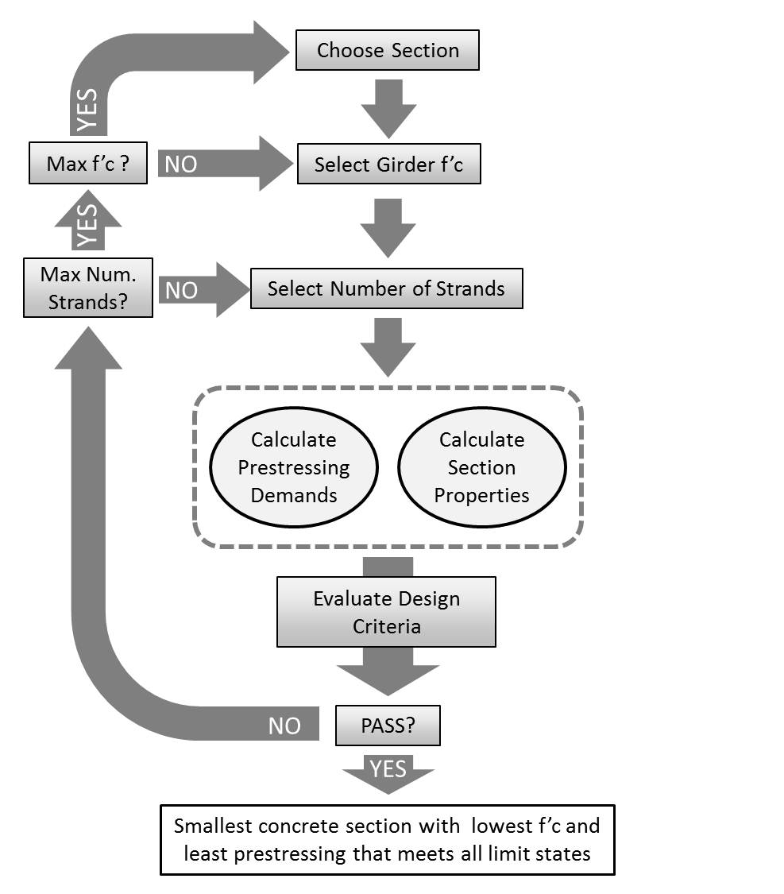
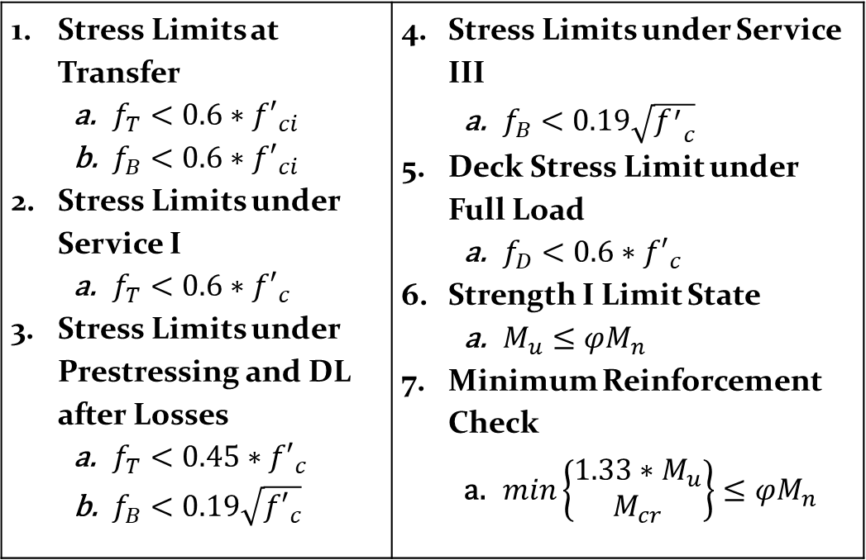
Prestressed Design
Stress Limits at Transfer $f_{T}<0.6∗{f′}_{ci}$ $f_{B}<0.6∗{f′}_{ci}$ Stress Limits under Service I $f_{T}<0.6∗{f′}_{c}$ Stress Limits under Prestressing and DL after Losses $f_{T}<0.45∗{f′}_{c}$ $f_{B}<0.19\sqrt{{f′}_{c}}$ | Stress Limits under Service III $f_{B}<0.19\sqrt{{f^{′}}_{c}}$ Deck Stress Limit under Full Load $f_{D}<0.6∗{f′}_{c}$ Strength I Limit State $M_{u}≤{φM}_{n}$ Minimum Reinforcement Check $min\left\{\begin{matrix}1.33∗M_{u} \\ M_{cr}\end{matrix}\right\}≤φM_{n}$

Slide 9
Designed 18 Bridges
Span Length (ft) | Width (ft) | Girder Spacing (ft) | Number of Girders | Type | Section Name | Beam Depth (in) | Mn (kip-ft)
50 | 42 | 6 | 8 | AASHTO | AASHTO2 | 36 | 1675
50 | 40 | 8 | 6 | AASHTO | AASHTO2 | 36 | 1955
50 | 36 | 12 | 4 | AASHTO | AASHTO2 | 36 | 2795
100 | 42 | 6 | 8 | AASHTO | AASHTO4 | 54 | 5971
100 | 40 | 8 | 6 | AASHTO | AASHTO4 | 54 | 7547
100 | 36 | 12 | 4 | AASHTO | AASHTO4 | 54 | 20556
150 | 42 | 6 | 8 | AASHTO | AASHTO6 | 72 | 13747
150 | 40 | 8 | 6 | AASHTO | AASHTO6 | 72 | 17565
150 | 36 | 12 | 4 | AASHTO | AASHTO6 | 72 | 32763
50 | 42 | 6 | 8 | Rolled | NA | 23.9 | 1754
50 | 40 | 8 | 6 | Rolled | NA | 21.4 | 2175
50 | 36 | 12 | 4 | Rolled | NA | 21.8 | 2943
100 | 42 | 6 | 8 | Rolled | W40X264 | 40 | 6824
100 | 40 | 8 | 6 | Rolled | W40X264 | 40 | 7265
100 | 36 | 12 | 4 | Rolled | W44X262 | 43.3 | 8666
150 | 42 | 6 | 8 | Plate | NA | 60 | 16031
150 | 40 | 8 | 6 | Plate | NA | 60 | 16240
150 | 36 | 12 | 4 | Plate | NA | 60 | 17342

Slide 10
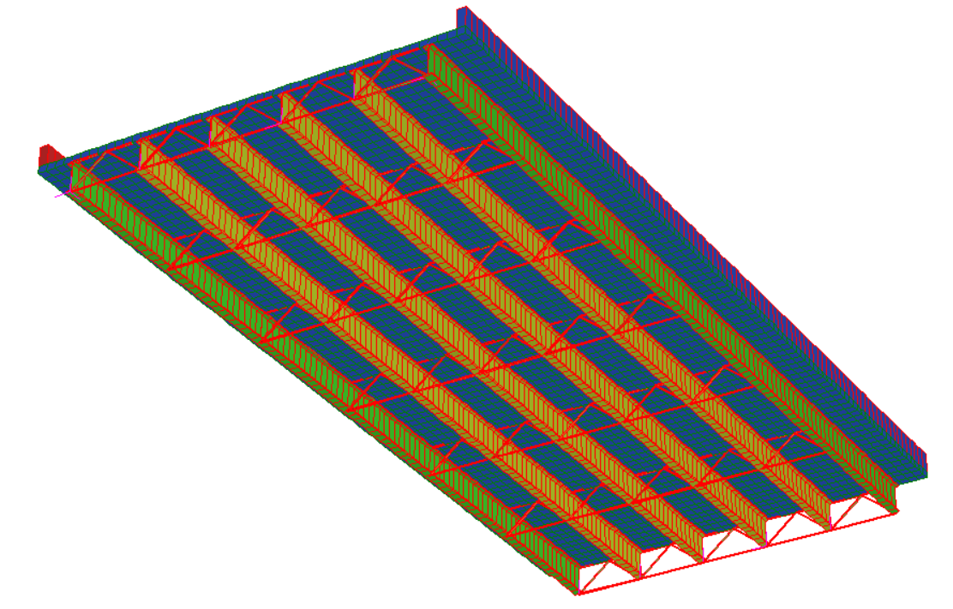
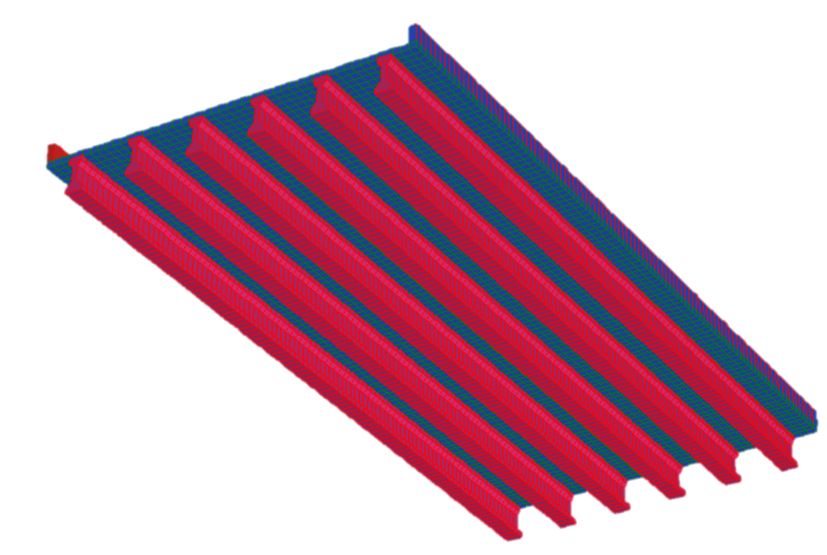
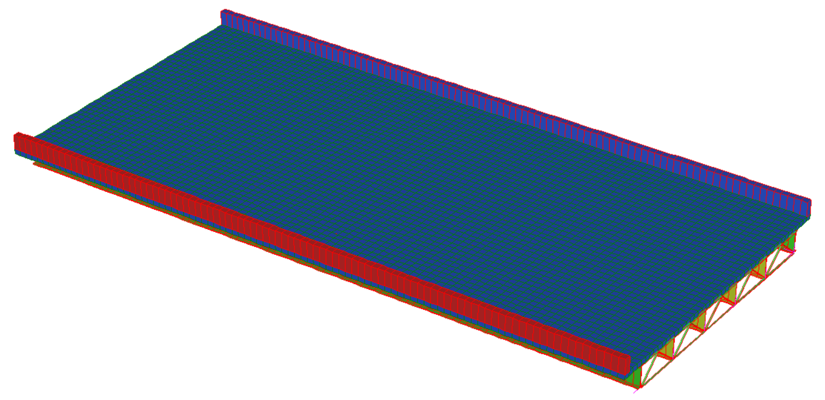
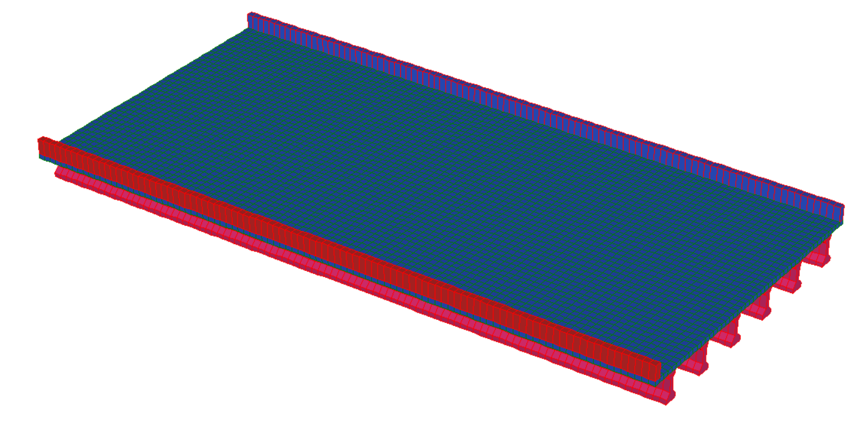
FE Modeling for Demand Estimation
100 ft. span length
8 ft. girder spacing
6 girders

Slide 11
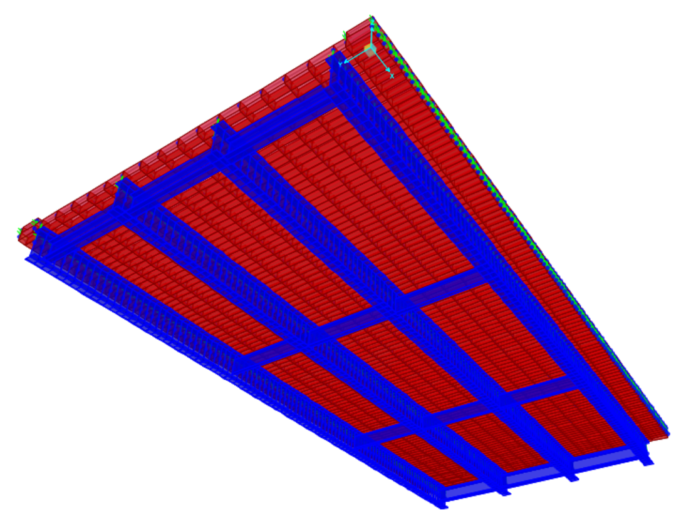
Next Steps for FE Modeling
Loss of composite action at girder ends and mid-span
Simulate the same defects examined for capacity estimation (delamination, loss of composite action, loss of prestressing strands)
Quantify the influence of the defects on element-level demands
HL-93 loading for load rating
Flexural demands at midspan and quarter span
Loss of prestressing strands at mid-span
Delaminations at mid-span center and edge

Slide 12
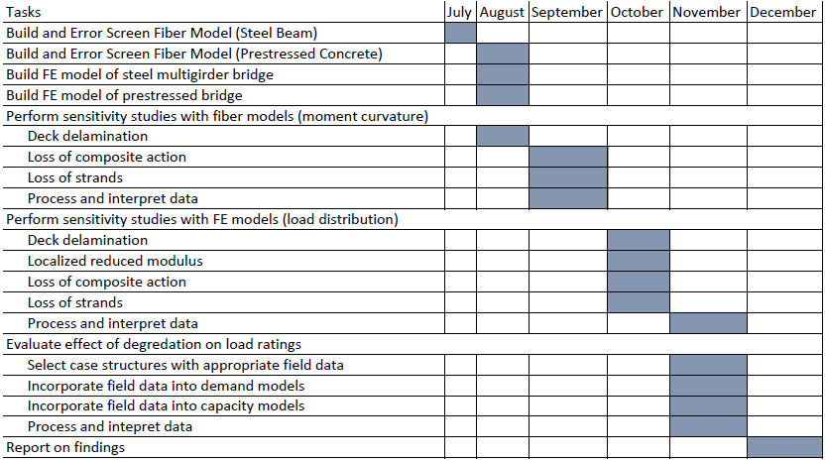
Schedule
Completed

